Slide 1
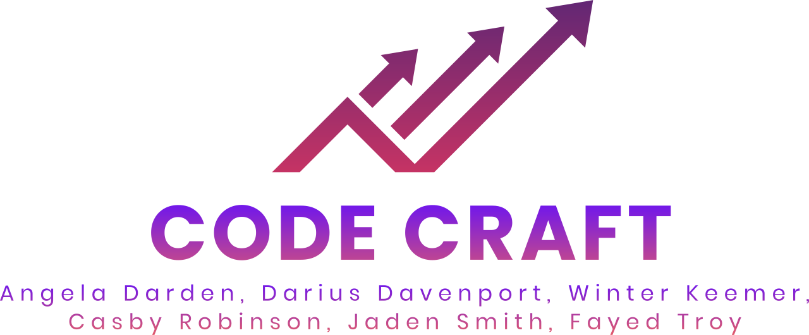

Slide 2
Agenda
01 → Team Introductions
02 → Project Introduction & Progress
03 →Product Deep Dive
04 →Live Demo

Slide 3
Team Introductions

Slide 4
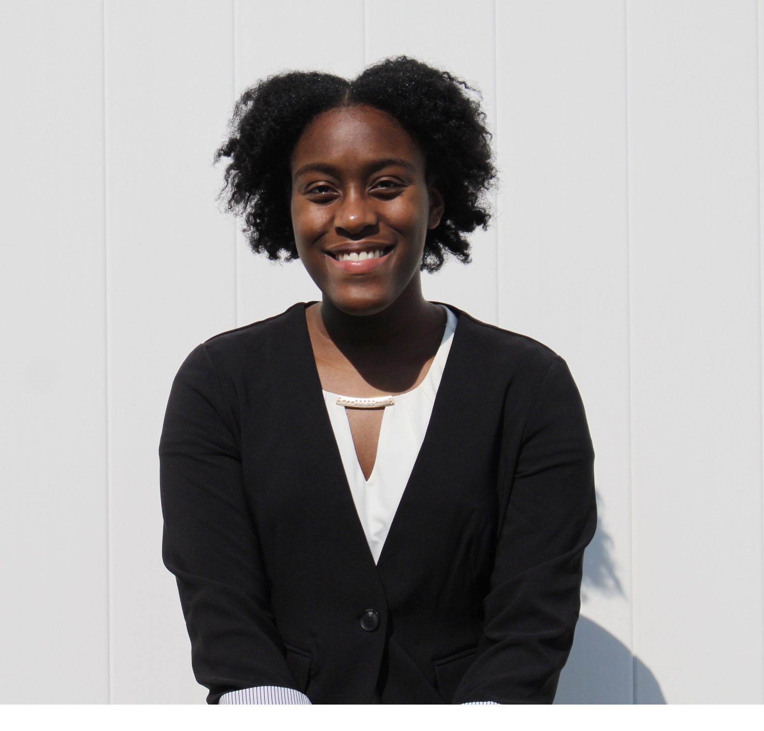
Angela Darden
Graduating Senior
Cyber Security - Computer Science Major
Fredericksburg, VA

Slide 5

Darius Davenport
Graduating Senior
Computer Science Major
Atlanta, GA

Slide 6
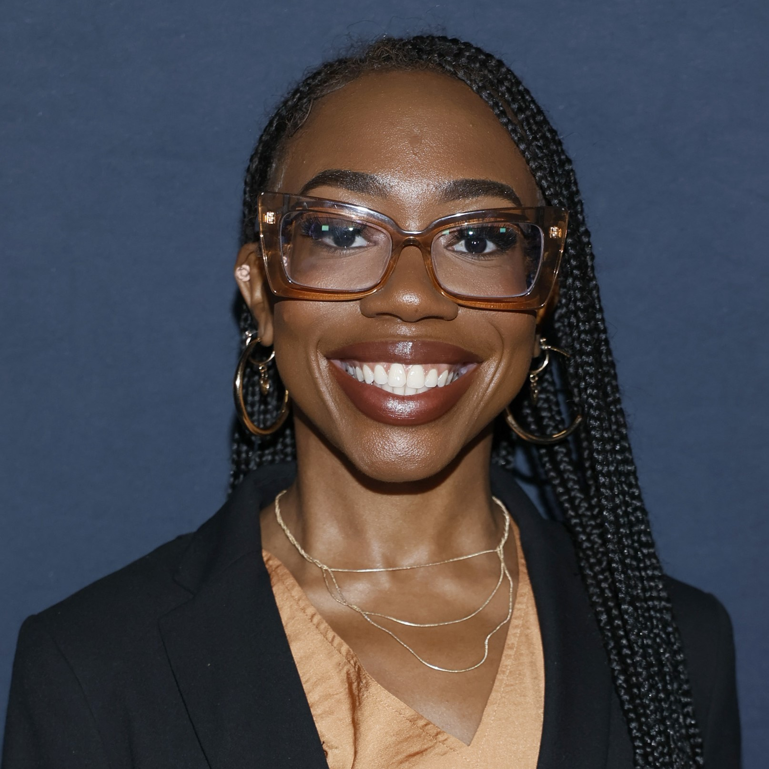
Winter Keemer
Graduating Senior
Cybersecurity Major, Computer Science
Prince George’s County, MD

Slide 7


Casby Robinson
Graduating Senior
Computer Information Systems
Upper Marlboro, MD

Slide 8
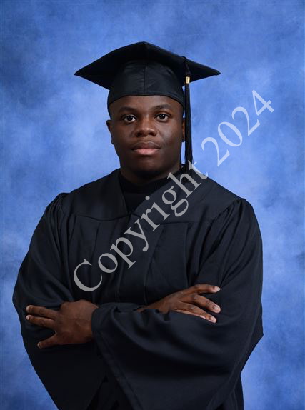
Jaden Smith
Graduating Senior
Computer Science Major
Bowie, MD

Slide 9
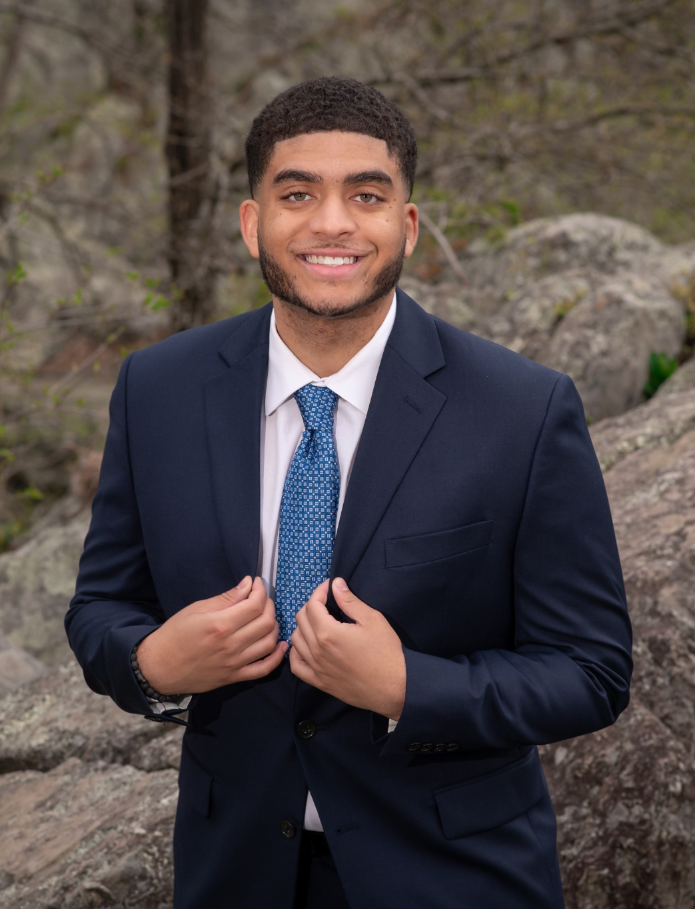
Fayed Troy
Graduating Senior
Computer Informations Systems major
Haymarket, VA

Slide 10
Project Introduction & Progress

Slide 11
Goals and Objectives
We were given the task to create a trading bot that would automatically buy, sell, and trade stocks. Our application should have the following:
Uses an API
Trading strategy
Uses a Trading Platform
Jaden
Notes:
Jaden

Slide 12
Project Timeline
Project was split into 5 different iterations
Iteration 1(January 11th-25th)
Assign team roles and objective
Requirements document
Project plan
Iteration 5(March 29th - April 23rd)
Focused majorly on product development
Test specification
Release candidate prototype of the product
Formal deliverables
Iteration 2(January 26th- February 15th)
Functional specification
Data flow and diagrams of potential product
Iteration 4 (March 8th - March 28th)
Product development
ReadMe
Design and functional additions based on product
Test specification
Early version of product release
Formal deliverables
Iteration 3(February 16th - March 7th) )
Design specification
Functional specification additions
Early version test specification
Updated version of previous docs
Fayed
Notes:
Jaden

Slide 13

Alpaca
Alpaca is a trading platform that provides users with access to algorithmic trading and investing through an API-first approach.
Focuses on:
Alpaca offers commission-free trading
tools for developing and executing trading algorithms
easy integration with various financial data sources.
Jaden
Notes:
Jaden

Slide 14
Product Deep Dive

Slide 15
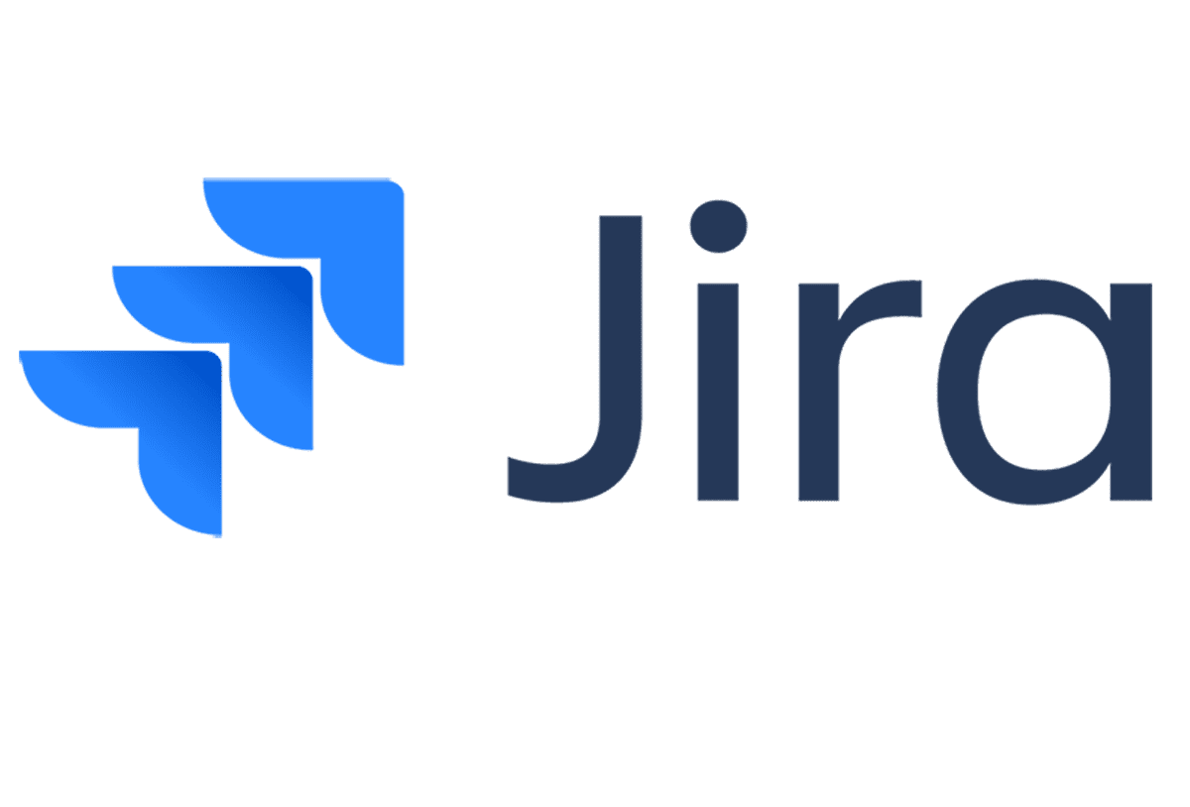

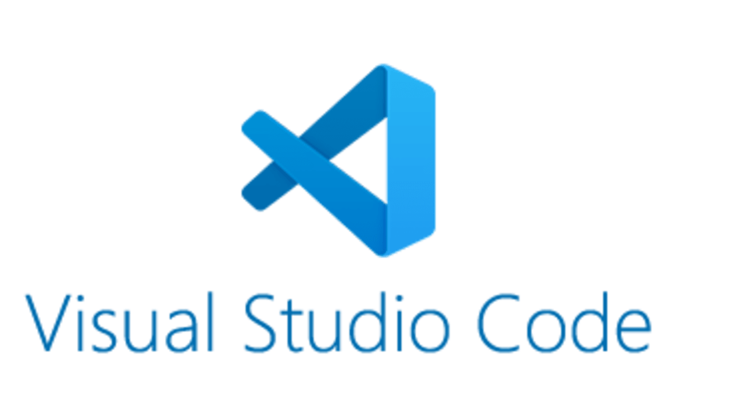


Tools Used
Fayed
Notes:
Fayed

Slide 16
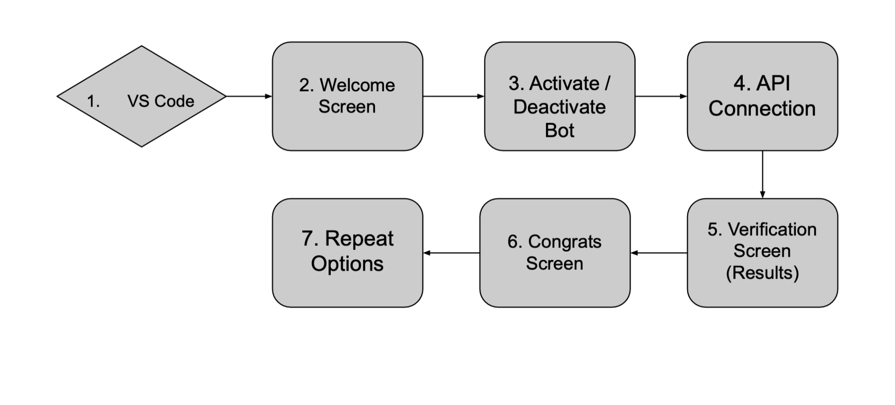
Recap: Product Diagram
Below displays 7 step flow chart of how the program works in totality
Fayed

Slide 17
Backend

Slide 18
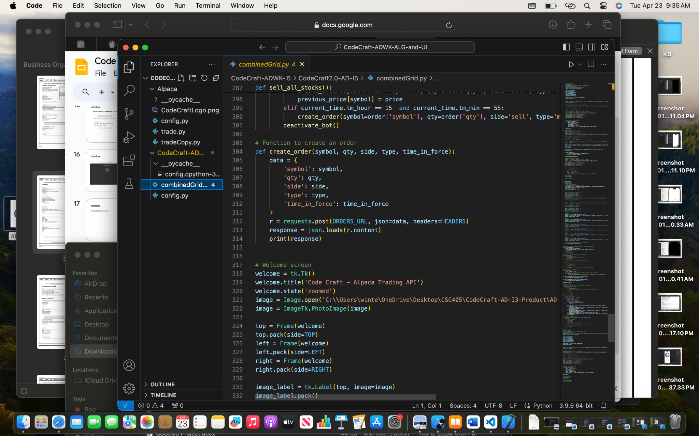
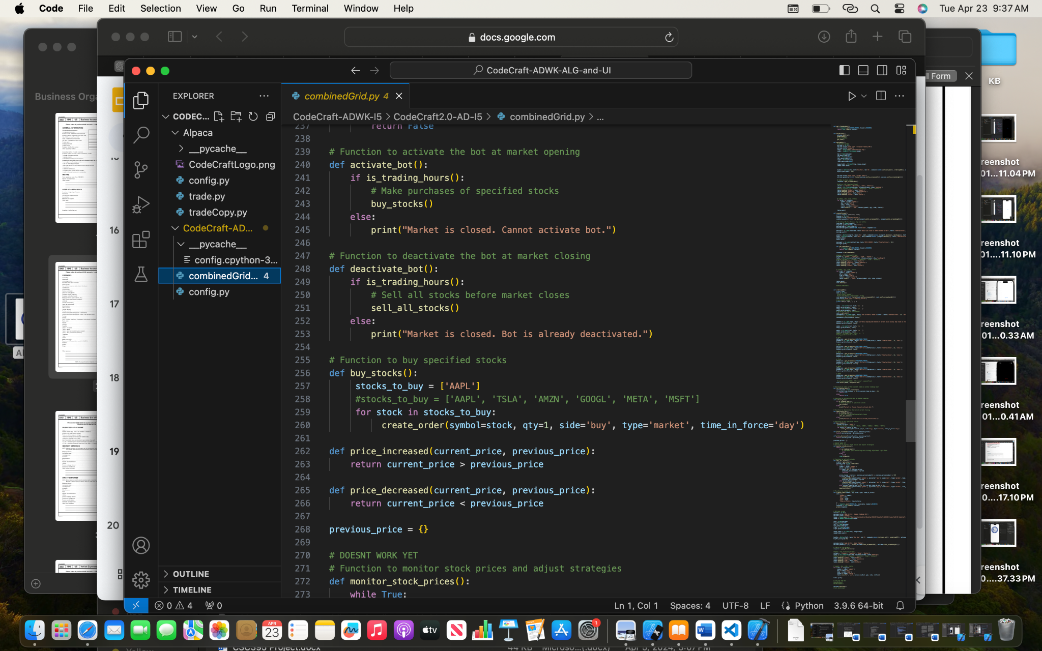
Algorithm - Activate Bot/Create Order
Casby

Slide 19
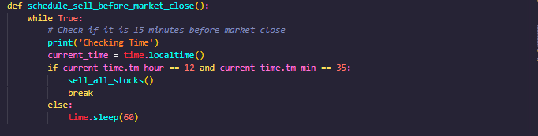
Day Trading Algorithm
Darius
Notes:
Fayed

Slide 20
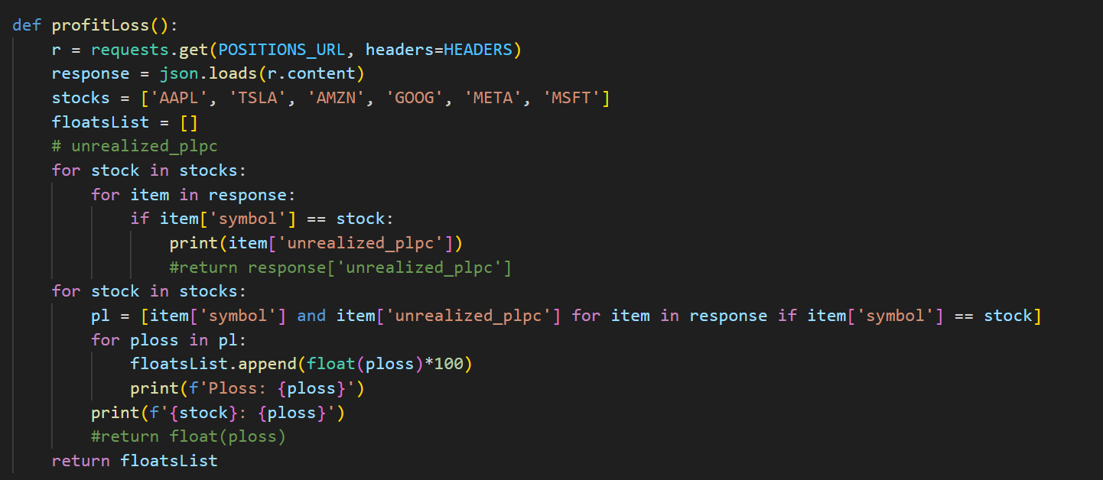
Trend Trading Algorithm
Angela
Notes:
Fayed

Slide 21
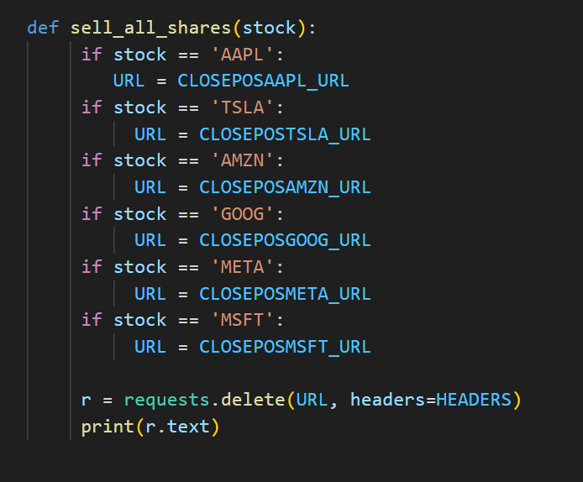
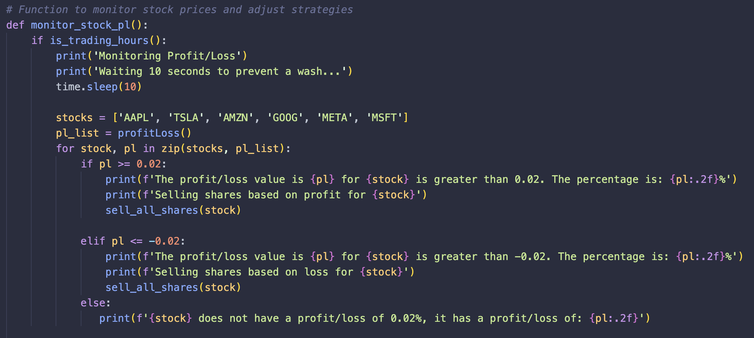
Trend Trading Algorithm Continued
Angela & Winter

Slide 22
Frontend

Slide 23
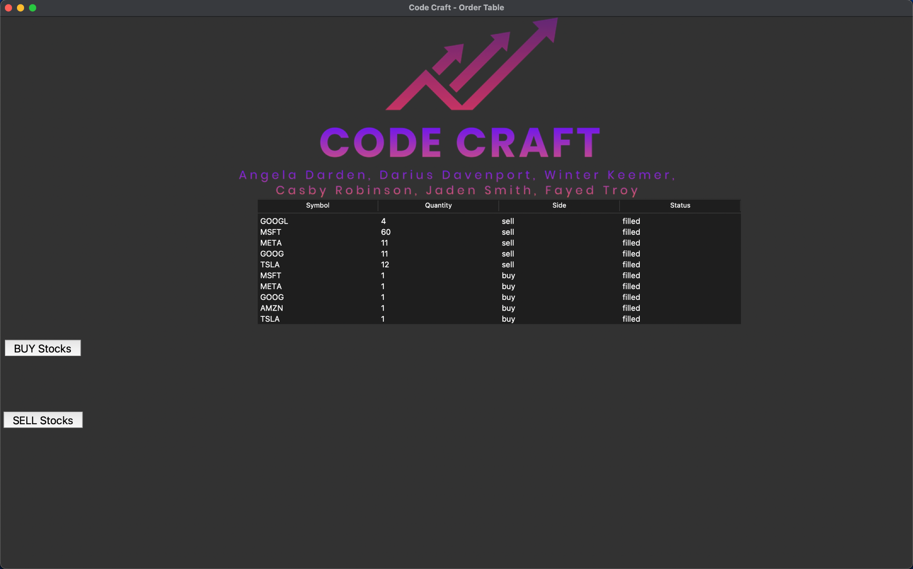
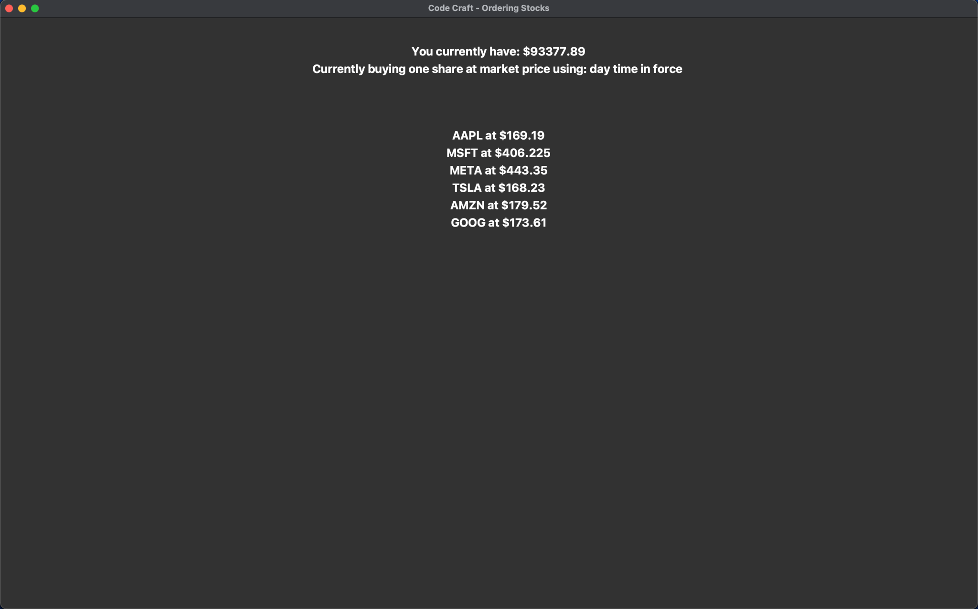
Verification Screen
Welcome Screen
Winter & Angela

Slide 24
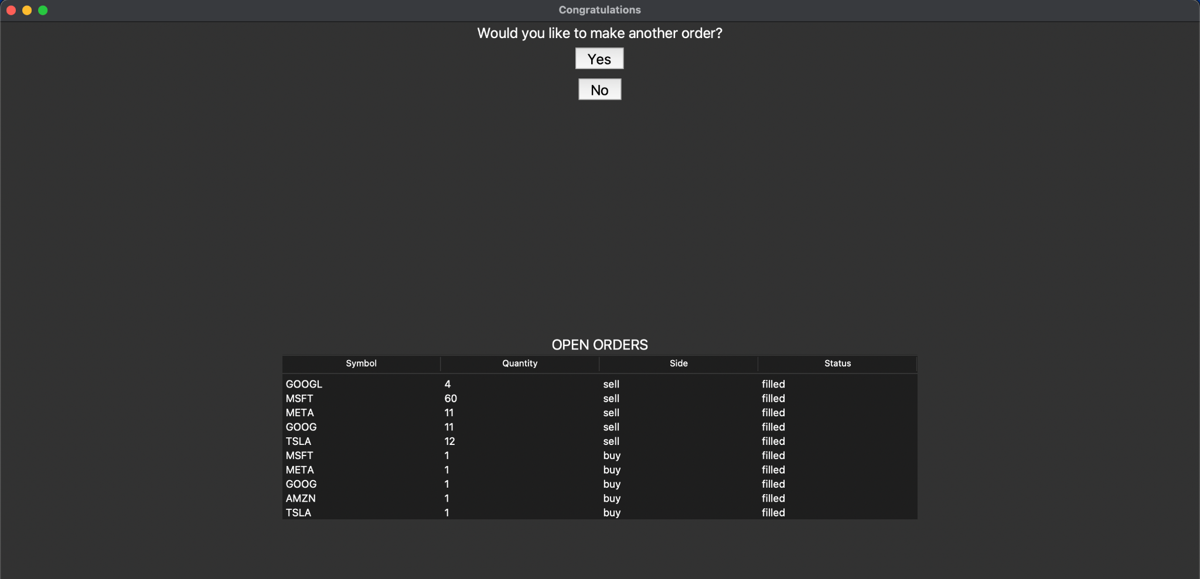
Congratulations Screen
Angela

Slide 25
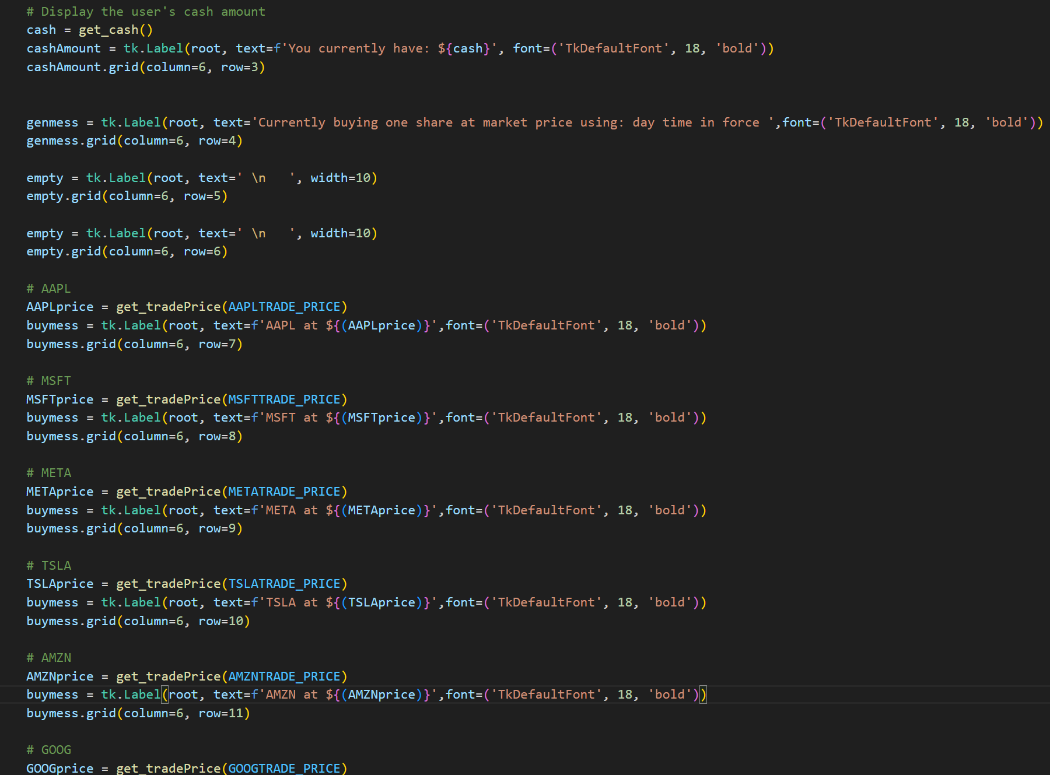
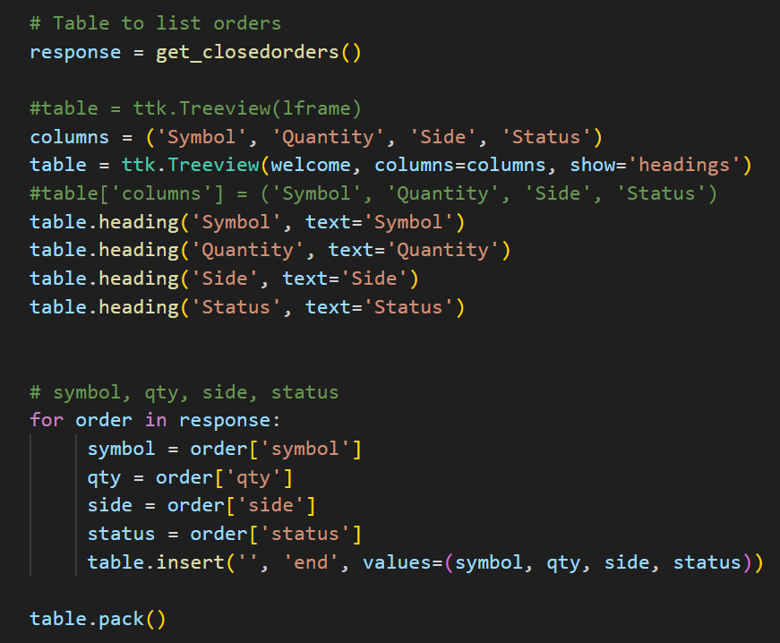
Frontend to Alpaca Connection
Angela & Winter

Slide 26
Live Demo

Slide 27

Notes:
Fayed

Slide 28
Thank you for listening!

